Slide 1
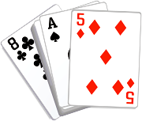
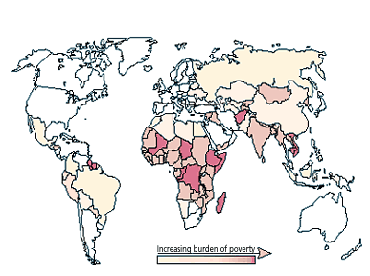
Higher or lower?
World Poverty
Does the next card have a higher or lower number?

Slide 2
There are about 6.5 billion people who live in the world
World Poverty
World Poverty
World Poverty
World Poverty
World Poverty
World Poverty
World Poverty
World Poverty
World Poverty

Slide 3
There are about 6.5 billion people who live in the world
2.8 billion people live in poverty in the world
World Poverty
World Poverty
World Poverty
World Poverty
World Poverty
World Poverty
World Poverty
World Poverty

Slide 4
There are about 6.5 billion people who live in the world
2.8 billion people live in poverty in the world
World Poverty
World Poverty
2 billion people don’t have access to electricity
World Poverty
World Poverty
World Poverty
World Poverty
World Poverty

Slide 5
There are about 6.5 billion people who live in the world
2.8 billion people live in poverty in the world
World Poverty
2 billion people don’t have access to electricity
18 million people die each year because of poverty
World Poverty
World Poverty
World Poverty
World Poverty
World Poverty

Slide 6
There are about 6.5 billion people who live in the world
2.8 billion people live in poverty in the world
2 billion people don’t have access to electricity
18 million people die each year because of poverty
600 million children live in poverty
World Poverty
World Poverty
World Poverty
World Poverty
World Poverty

Slide 7
There are about 6.5 billion people who live in the world
2.8 billion people live in poverty in the world
2 billion people don’t have access to electricity
18 million people die each year because of poverty
600 million children live in poverty
World Poverty
World Poverty
World Poverty
World Poverty
1 billion people live on less than 70p a day

Slide 8
There are about 6.5 billion people who live in the world
2.8 billion people live in poverty in the world
2 billion people don’t have access to electricity
18 million people die each year because of poverty
600 million children live in poverty
10 million children die each year because of poverty
World Poverty
World Poverty
World Poverty
1 billion people live on less than 70p a day

Slide 9
There are about 6.5 billion people who live in the world
2.8 billion people live in poverty in the world
2 billion people don’t have access to electricity
18 million people die each year because of poverty
600 million children live in poverty
10 million children die each year because of poverty
World Poverty
World Poverty
130 million children don’t have a primary school to attend
1 billion people live on less than 70p a day

Slide 10
There are about 6.5 billion people who live in the world
2.8 billion people live in poverty in the world
2 billion people don’t have access to electricity
18 million people die each year because of poverty
600 million children live in poverty
10 million children die each year because of poverty
World Poverty
130 million children don’t have a primary school to attend
1 billion people live on less than 70p a day
1 billion people drink unclean water

Slide 11
There are about 6.5 billion people who live in the world
2.8 billion people live in poverty in the world
2 billion people don’t have access to electricity
18 million people die each year because of poverty
600 million children live in poverty
10 million children die each year because of poverty
½ million women die each year in pregnancy or childbirth
130 million children don’t have a primary school to attend
1 billion people live on less than 70p a day
1 billion people drink unclean water

